Slide 1
Urban Land-Use Theories

Slide 2
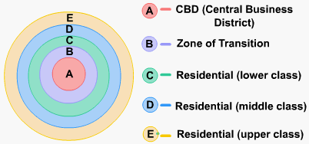
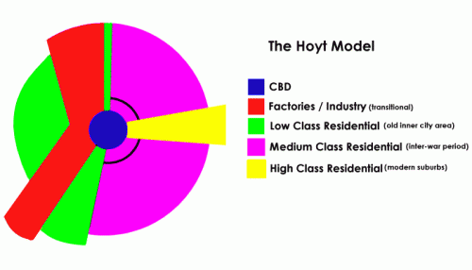
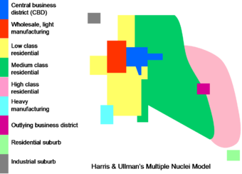
Three key theories
Burgess – Concentric Zone
Hoyt – Sector Model
Harris and Ullman – Multiple Nuclei

Slide 3
Concentric zone model
1

Slide 4
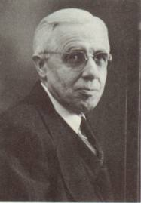
Urban Land-Use Theories
Concentric Zone Theory
Burgess (1925)
Cities grow outwards from the centre in a series of rings.

Slide 5
Concentric Zone Theory
Timeframe
1920’s
Class conscious society
Housing segregated according to income
Lack of transport infrastructure
Assumptions
Older buildings in city centre
Newer buildings at edge of city
Land values highest in city centre
Strong economic and ethnic segregation
Low income groups lack transport and live close to city centre.
Cities develop on a flat plain with equal access to transport

Slide 7
Five Concentric Zones
1) Central Business District
2) Transition and Industry
low incomes
oldest housing
ghettos
3) Low Income Residential
4) Middle Income Residential
suburban estates- good quality, gardens
5) High Income Residential / Commuter
Small towns and villages

Slide 8
Problems with Burgess Model
Doesn't consider car ownership
Landscape not considered
Impact that industry and transport could have on land use not considered.
Zones are never as clear-cut

Slide 10
Hoyt’s Sector Model
1939
Sectors radiating out from the CBD along transport routes.

Slide 11
Sector Theory
Timeframe
Late 1930’s
Income and status divided society
Housing areas reflect social segregation
Assumptions
Settlement develops along transport routes
Towns radiate out from the CBD
Low-income and industrial areas lie next to each other
Wealthy people choose the best sites

Slide 12
Criticisms of Hoyt’s Theory
Too general
In reality, most zones contain more than one land-use

Slide 13
Multiple nuclei model
3

Slide 14
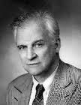
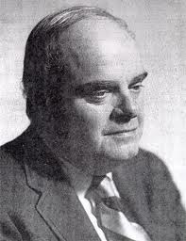
Harris and Ullman’s Multiple Nuclei Theory
1945
As an urban area grows, it develops around a number of different business centres or nuclei.

Slide 15
Multiple Nuclei Theory
Assumptions;
Modern cities more complex than suggested by other theorists
Each nucleus acts as a growth point
Growth occurs outwards from each nucleus, until they all merge into one large urban area

Slide 16
Multiple Nuclei Theory
Mixture of Burgess and Hoyt
Shows some land-uses attract more of the same, for example industrial areas
Some land-uses may deter others from locating nearby, eg; housing is usually located away from industrial areas

Slide 17
Criticisms of Multiple Nuclei Theory
Not an exact fit for all cities and towns
Too complex

Slide 18
Are these models relevant to today’s cities??
Have some relevance
Now due to urban renewal schemes and changes in society, high income residential areas often exist close to the CBD
Modern cities are expanding beyond these models- Urban Sprawl

